Slide 1
The Curse of Dimensionality
Notes:
- Make comments on the changes made, in particular, to the source of the diagrams

Slide 2
Preliminaries – Nearest Neighbor Search
Given a collection of data points and a query point in m-dimensional metric space, find the data point that is closest to the query point
Variation: k-nearest neighbor
Relevant to clustering and similarity search
Applications: Geographical Information Systems, similarity search in multimedia databases
Notes:
Why talk about NN-search? It will be affected by the curse
In multiple dimensions, represent objects a vector of values (feature vector) which you can visualize as a point in multi-dimensional hyperspace
K-Means method: Assign points to the closest cluster mean

Slide 3
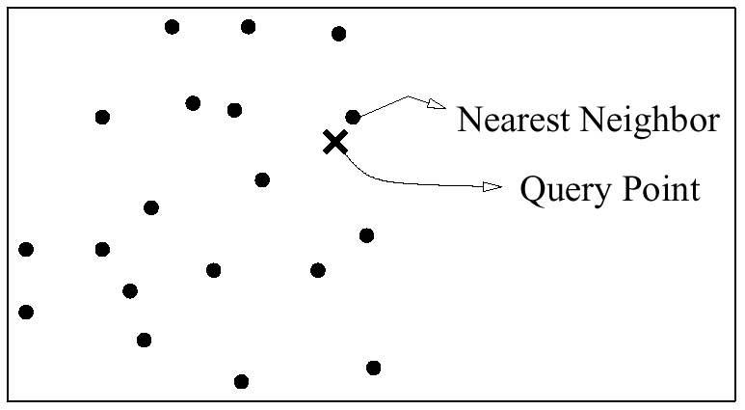
NN Search Con’t
Source: [2]

Slide 4
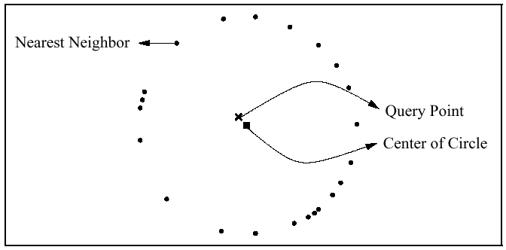
Problems with
High Dimensional Data
A point’s nearest neighbor (NN) loses meaning
Source: [2]
Notes:
Loses meaning = no significant difference in distance between query pt and NN and between query and other pts including the farthest, ie. little contrast

Slide 5
Problems Con’t
NN query cost degrades – more strong candidates to compare with
In as few as 10 dimensions, linear scan outperforms some multidimensional indexing structures (e.g. SS tree, R* tree, SR tree)
Biology and genomic data can have dimensions in the 1000’s.
Notes:
When access index, we get many candidates (due to little contrast problem); access almost entire database
If things can get bad in 10 dimensions, imagine biology data where objects can have 1000’s of attributes

Slide 6
Problems Con’t
The presence of irrelevant attributes decreases the tendency for clusters to form
Points in high dimensional space have high degree of freedom; they could be so scattered that they appear uniformly distributed
Notes:
Irrelevant attributes can mask real clusters; in high dim’s, there is an increased likelihood of irrelevant attrib’s
To solve first problem, we could find and remove the irrelevant attribute and select the relevant ones

Slide 7
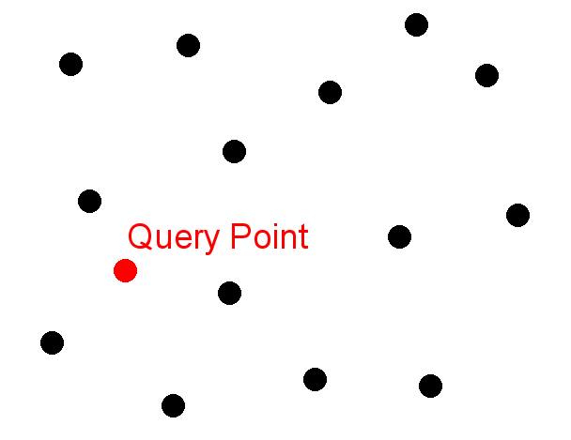
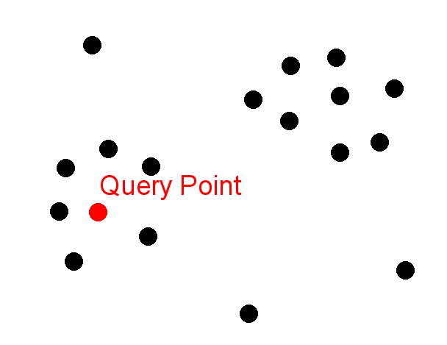
Problems Con’t
In which cluster does the query point fall?
Notes:
First picture, all pairs of data points almost equidistant from one another; points that are uniformly distributed do not separate out well into clusters
Why do we care? Because we can classify the query point as being in same class as NN, and perhaps predict the behavior of that query point based on the behavior common to the points in the cluster (character recognition example)

Slide 8
The Curse
Refers to the decrease in performance of query processing when the dimensionality increases
The focus of this talk will be on quality issues of NN search and on not performance issues
In particular, under certain conditions, the distance between the nearest point and the query point equals the distance between the farthest and query point as dimensionality approaches infinity
Notes:
In particular, curse refers to the decrease in performance of the indices
I will discuss 3 issues: The meaning of proximity (or lack of) in high dimensional space; the behavior of the L_{k} metric (smaller k is better), and a solution to the lack of meaning problem (work in lower dimensions)
Bottom problem is known as instability

Slide 9
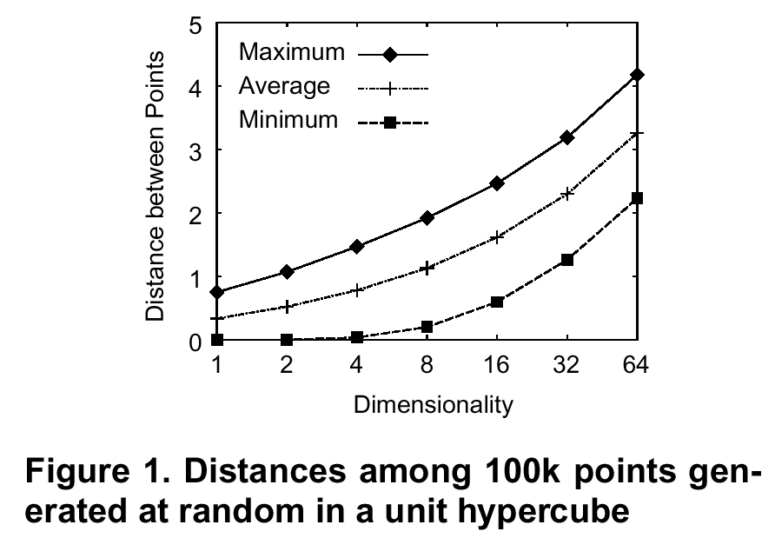
Curse Con’t
Source: N. Katayama, S. Satoh. Distinctiveness Sensitive Nearest Neighbor Search for Efficient Similarity Retrieval of Multimedia Information. ICDE Conference, 2001.
Notes:
They invented SR tree
SKIP THIS SLIDE

Slide 10
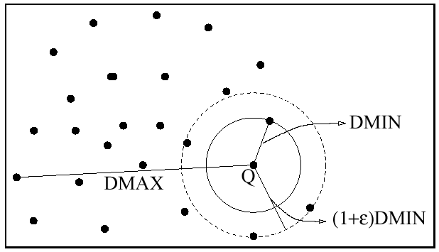
Unstable NN-Query
A nearest neighbor query is unstable for a given ε > 0 if the distance from the query point to most data points is less than (1+ε) times the distance from the query point to its nearest neighbor
Source: [2]
Notes:
If most points are in the circle of radius 1+e then NN-queries will be unstable
In this picture we don’t have this problem

Slide 11
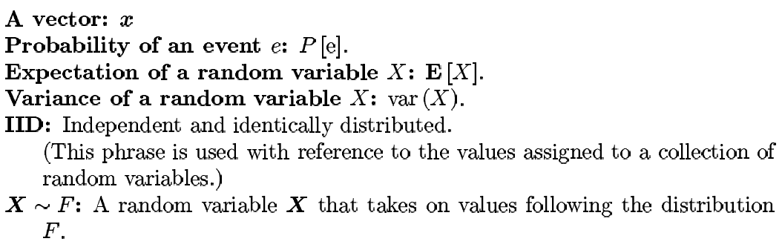

Notation

Slide 12
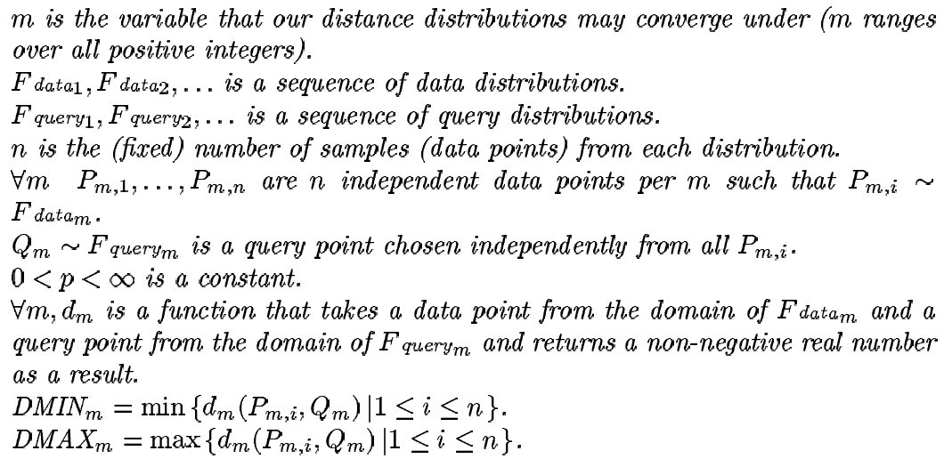
Definitions
Notes:
m = dimensionality (although I might use d sometimes)
Note that there are no restrictions on the distance function
p can be the p in an L_{p} distance metric

Slide 13
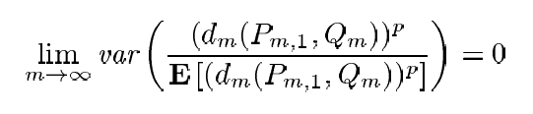

Theorem 1
Under the conditions of the above definitions, if
Then for any ε > 0,
If the distance distribution behaves in the above way, as dimensionality increases, all points will approach the same distance from the query point
Notes:
Conditions: data points independent, query points chosen independently from all data pts
Does not say anything about distribution of the dimensions of a point (can be normal, uniform, etc., and can be different for each dimension) or whether dimensions are independent
Another way of thinking about this: Ratio of DMAX over DMIN approaches 1;
Basically, theorem says that the concept of proximity breaks down under certain conditions
I will talk more about the conditions later

Slide 14
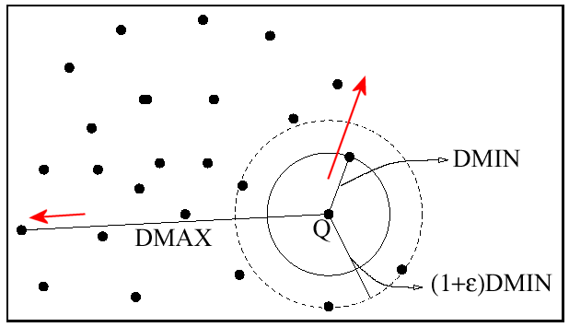
Theorem Con’t
Source: [2]
Notes:
Ratio of DMAX over DMIN approaches 1: DMIN grows faster than DMAX, so ratio will approach 1

Slide 15
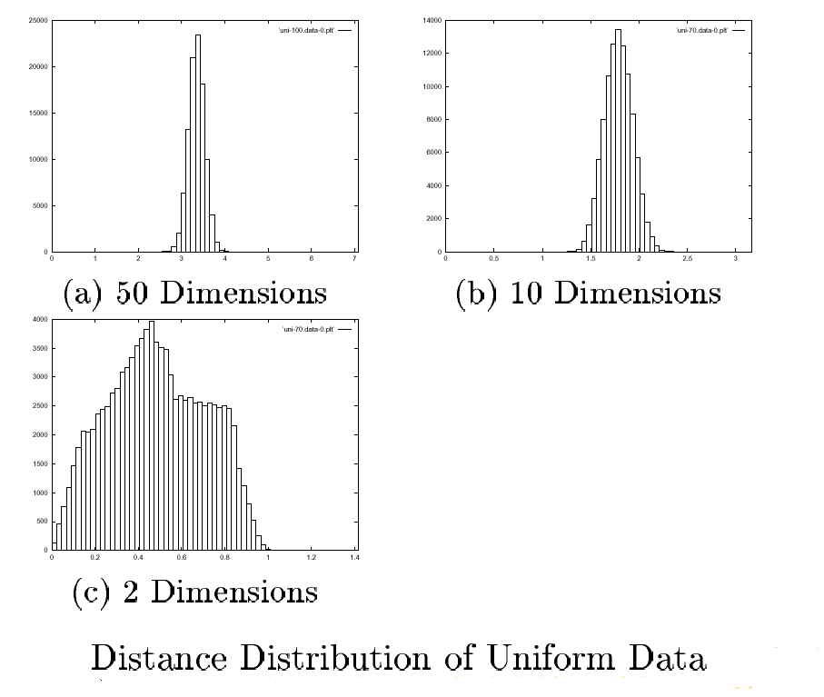
Theorem Con’t
Source: [1]
Notes:
Figure: Distance distribution of the distance between query point and data points
As dimensionality increases, all the data points are basically same distance from the query point

Slide 16
Rate of Convergence
At what dimensionality does NN-queries become unstable. Not easy to answer, so experiments were performed on real and synthetic data.
If conditions of theorem are met, DMAX_{m}/DMIN_{m} should decrease with increasing dimensionality
Notes:
Rate of Convergence = How fast do things go bad?

Slide 17
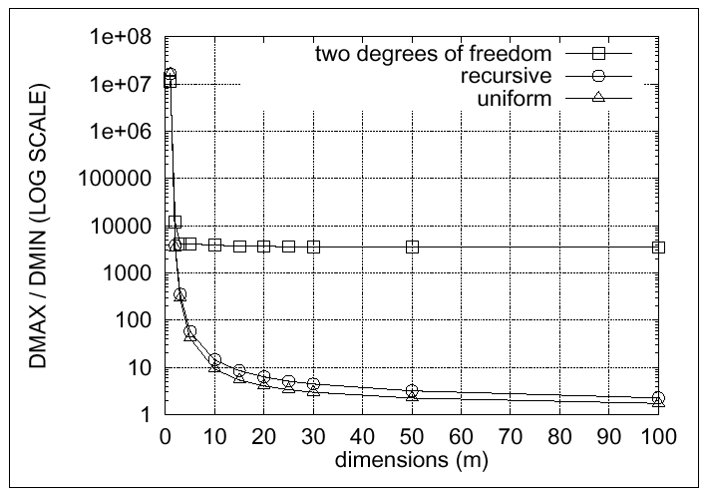
Empirical Results
Source: [2]
Notes:
From synthetic data
Two degrees of freedom does not satisfy the condition of the theorem
Instability appears in as few as 10-20 dimensions
Results for real data are basically the same (diagram not included)

Slide 18
An Aside
Assuming that theorem 1 holds, when using the Euclidian distance metric, and assuming that the data and query point distributions are the same, the performance of any convex indexing structure degenerates into scanning the entire data set for NN queries
i.e., P(number of points fetched using any convex indexing structure = n) converges to 1 as m goes to ∞
Notes:
index is convex if it divides the data into sets of convex regions of space, and if a query region overlaps the convex region associated with a set, we must fetch the points within that set
each set has some info associated with it. NN-querying involves looking at the info, if info indicates existence of a candidate point, we fetch the set and check all points in it
See Shaft, U., Goldstein, J., Beyer, K. Nearest Neighbors Query Performance for Unstable Distributions. Technical Report No. TR1388, Computer Sciences Dept., Univ. of Wisconsin-Madison, October 1998.

Slide 19
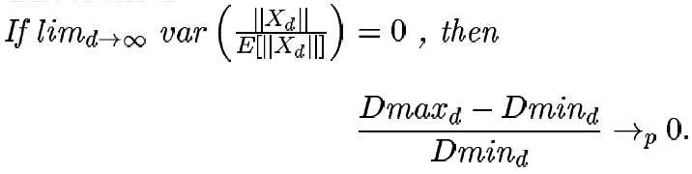
Alternative Statement of Theorem 1
Distance between nearest and farthest point does not increase as fast as distance between query point and NN as dim approaches infinity
Note: Dmax_{d} – Dmin_{d} does not necessarily go to 0
Notes:
d == m == # of dimensions
For only cosmetic reasons, the statement here assumes the origin is the query point (this doesn’t change the generality of the result since we can still use distance from X_{d} to any query point other than origin)

Slide 20
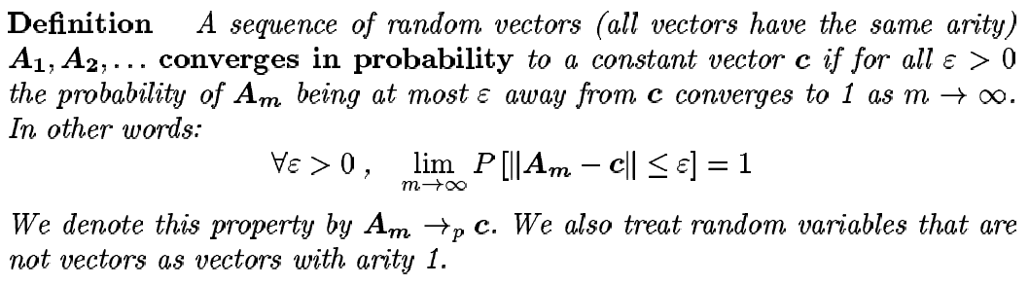
Alternative Statement Con’t
Notes:
- || || means distance

Slide 21
Background for
Theorems 2 and 3
L_{k} norm: L_{k}(x,y) = sum(i=1 to d) (||x_{i} - y_{i}||^{k})^{1/k} where x, y ∈ R^{d}, k ∈ Z
L₁: Manhattan, L₂: Euclidean
L_{f} norm: L_{f}(x,y) = sum(i=1 to d) (||x_{i} - y_{i}||^{f})^{1/f} where x, y ∈ R^{d}, f ∈ (0,1)
Notes:
What happens to distance metrics in high dimensional space?

Slide 22
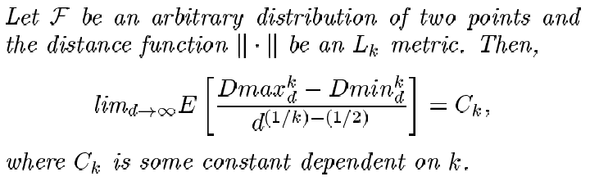
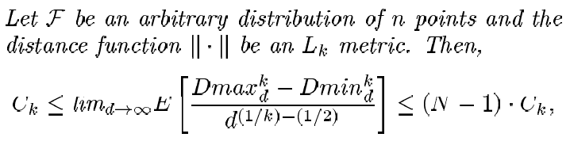
Theorem 2
Dmax_{d} – Dmin_{d} grows at rate d^{(1/k)-(1/2)}
Notes:
Notes: not power k, but using L_{k} metric
As k increases, Dmax_{d} – Dmin_{d} will shrink faster; for k = 1, it will grow (in order to keep the expected value a constant)
Assumption: The values x_{i} in each dimension all have the same distribution F (between 0 and 1)

Slide 23
Theorem 2 Con’t
For L₁, Dmax_{d} – Dmin_{d} diverges
For L₂, Dmax_{d} – Dmin_{d} converges to a constant
For L_{k} for k >= 3, Dmax_{d} – Dmin_{d} converges to 0. Here, NN-search is meaningless in high dimensional space
Notes:
L₁, L₂ ok discrimination between farthest and nearest neighbor
L₁ better than L₂
Convergence to 0 increases with increasing k

Slide 24
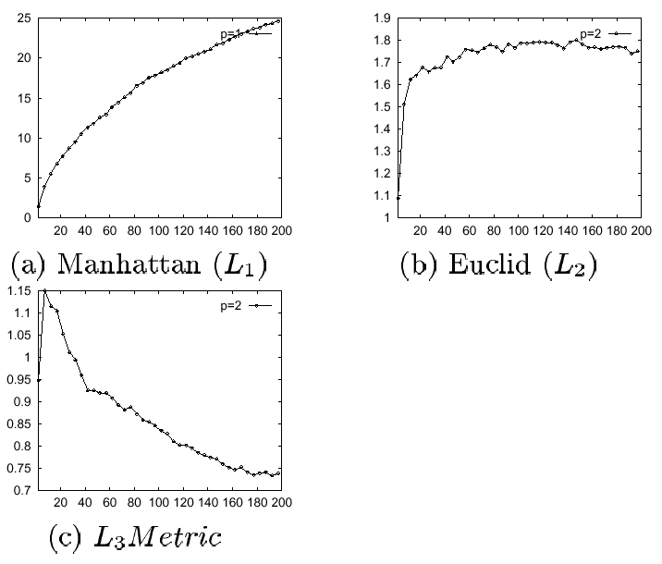
Theorem 2 Con’t
Source: [1]
Notes:
Y-axis: Dmax_{d} – Dmin_{d} (averages from real and synthetic data)
X-axis dimensionality
(authors did not spend much time describing the experiments that yielded this data)

Slide 25
Theorem 2 Con’t
Contradict Theorem 1?
No, Dmin_{d} grows faster than Dmax_{d} – Dmin_{d} as d increases
Notes:
Does Theorem 2 contradict Theorem 1, refer to picture of L₁ metric diverging
Although I did not show it, the ratio Dmax_{d} – Dmin_{d}/Dmin_{d} approaches 0 faster for higher k in the L_{k} metric

Slide 26
Theorem 3
Same as Theorem 2 except replace k with f.
The smaller the fraction, the better the contrast
Meaningful distance metric should result in accurate classification and be robust against noise
Notes:
Theorem 3: Dmax_{d} – Dmin_{d} grows at rate d^{(1/f)-(1/2)}
For L_{f} metric, Dmax_{d} – Dmin_{d} diverges to 0 even faster than for L₁ metric
Result surprising since Euclidean distances are typically used
Although from mathematical point of view, L_{f} norm is preferred over Euclidean; from a human’s point of view, Euclidean is more understandable
Last point refers to the experimental data in the next slide

Slide 27
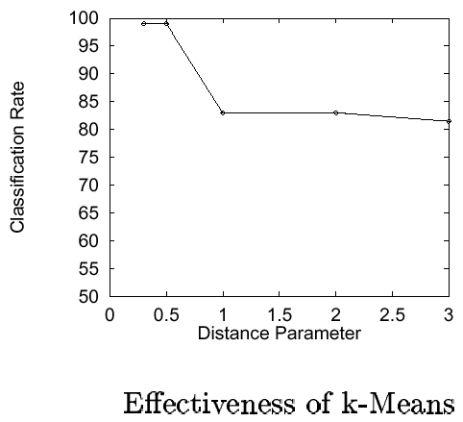
Empirical Results
Fractional metrics improve the effectiveness of clustering algorithms such as k-means
Source: [3]
Notes:
Synthetic data, cluster centers uniformly distributed; within cluster, points are normally distributed
Data consists of 6 known clusters, 10,000 data points, dimensionality 20
Measure how often we correctly put a point in the right cluster when we run the k-Means algorithm

Slide 28
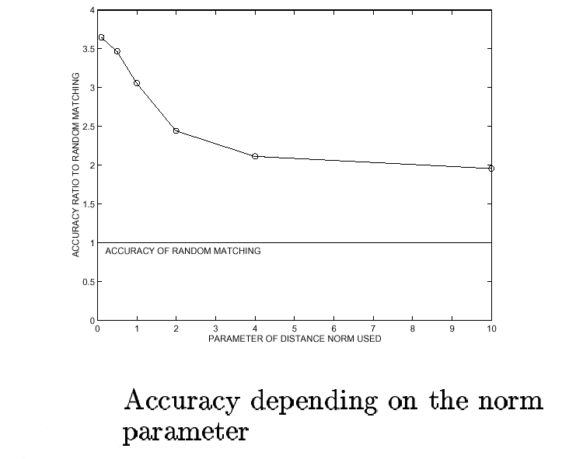
Empirical Results Con’t
Source: [3]
Notes:
CAN SKIP THIS SLIDE
real data
Query points were picked from the database then each query point’s L nearest neighbors were found
Accuracy: Total # of neighbors identified as being in the same class as query point out of the closest L neighbors
Explanation for decrease in accuracy: As k increases, we are progressively giving more weight to the irrelevant dimensions

Slide 29
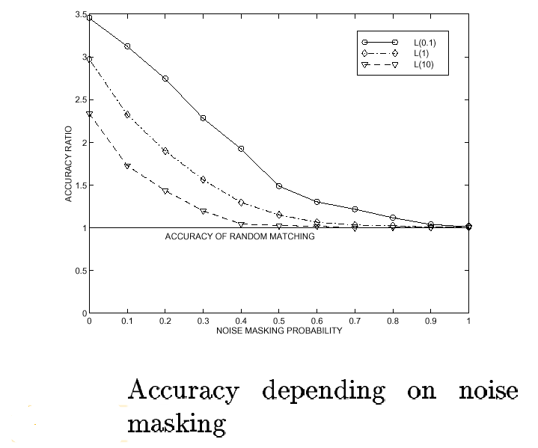
Empirical Results Con’t
Source: [3]
Notes:
With noise probability p, we replace each entry in database with random entry
Note that the accuracy of L_{0.1} degrades slower than L₁₀ so L_{0.1} is more robust to noise

Slide 30
Some Scenarios that Satisfy the Conditions of Theorem 1
More broad than the common IID assumption for the dimensions
Sc 1: For P=(P₁,…,P_{m}) and Q=(Q₁,…,Q_{m}), P_{i}’s IID (same for Q_{i}’s), and up to the ⎡2p’th⎤ moment is finite
Sc 2: Pi’s, Qi’s not IID; distribution in every dimension is unique and correlated with all other dimensions
Notes:
How often does the condition in Theorem 1 occur?
moment = expected value of powers of random variable, e.g. E[Y^2] = 2nd moment of Y

Slide 31
Scenarios Con’t
Sc 3: P_{i}’s, Q_{i}’s independent, not identically distributed, and variance in each added dimension converges to 0
Sc 4: Distance distribution cannot be described as distance in a lower dim plus new component from new dim; situation does not obey law of large of number
Notes:
- sc4: data points uniformly distributed on boundary of an m-dimensional hyper-cube. Distribution of query points same as for data points. Pi’s, Qi’s not independent

Slide 32
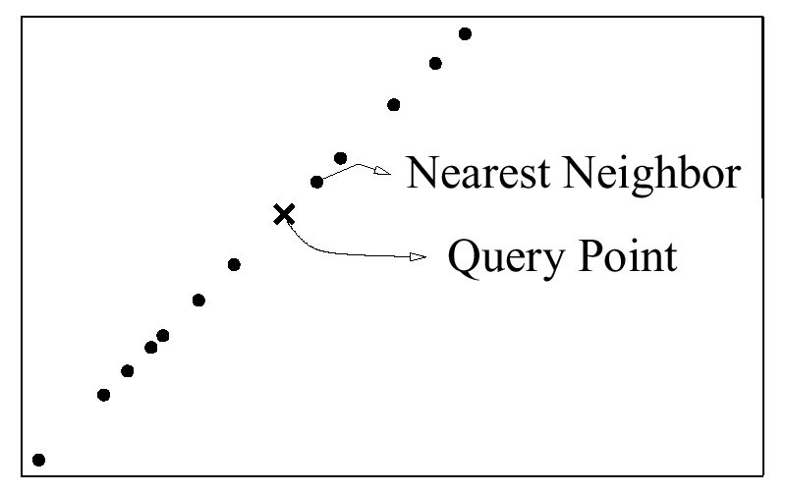
A Scenario that does not Satisfy the Condition
Sc 5: Same as 1 except P_{i}’s are dependent (i.e., value dim 1 = value dim 2) (same for Q_{i}’s). Can be converted into 1-D NN problem
Source: [2]
Notes:
- Conceptually, result is set of data pts and query pt on diagonal line

Slide 33
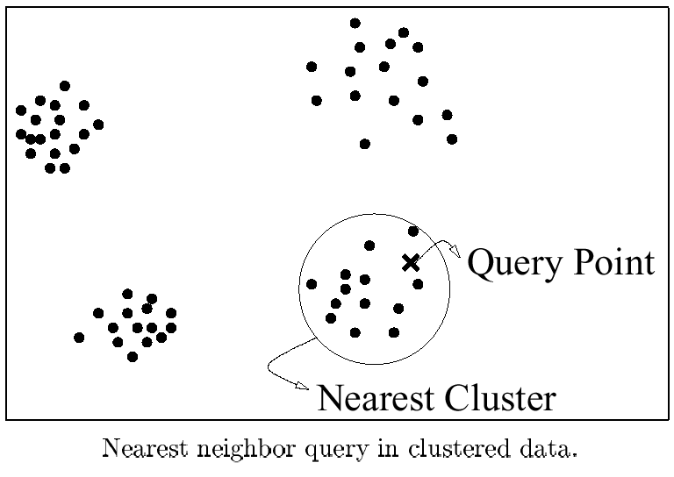
Scenarios in Practice that are Likely to Give Good Contrast
Source: [2]
Notes:
When data naturally falls into clusters/classes and query point falls in one of the clusters (return NN and should also return all points in the cluster);
If the above doesn’t happen, as dimensionality increases, nearest point increasingly becomes meaningless

Slide 34
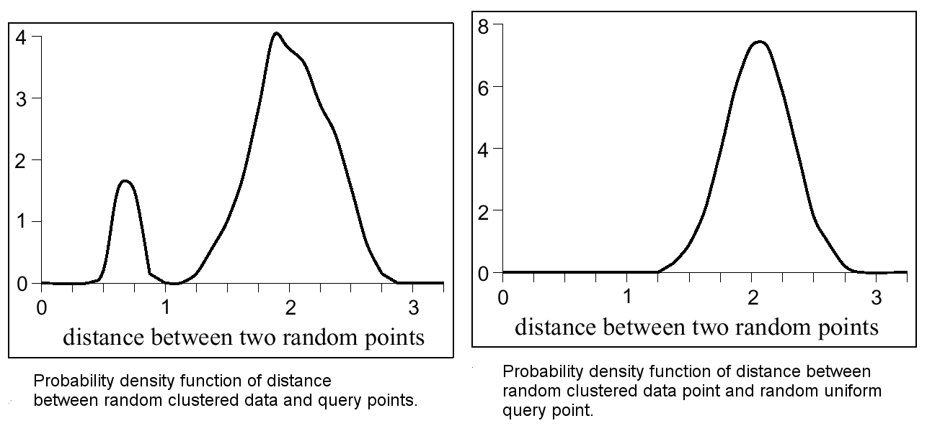
Good Scenarios Con’t
Source: [2]
Notes:
Nearer peak formed by points near query point; other peak formed by rest of points that have more or less the same far indistinguishable distance from the query point
1 peak means no meaningful cluster
Good idea to plot histogram for distance distribution (at least for sample of data) before report NN.

Slide 35
Good Scenarios Con’t
When the number of meaningful/relevant dimensions is low
Do NN-search on those attributes instead
Projected NN-search: For a given query point, determine which combination of dimensions (axes-parallel projection) is the most meaningful.
Meaningfulness is measured by a quality criterion
Notes:
- Basic Idea: to handle complexity we abstract away from the details.

Slide 36
Projected NN-Search
Quality criterion: Function that rates quality of projection based on the query point, database, and distance function
Automated approach: Determine how similar the histogram of the distance distribution is to a two peak distance distribution
Two peaks = meaningful projection
Notes:
Recall probability density function diagram in good scenario slide
One peak (usually shorter one) represents points similar to query point (and at least comparable) with respect to the given attributes. Other peak (usually larger), represents points far from query point (perhaps other attributes that were not included would tell a different story). These points behave like noise surrounding the query point.
Why 2? If more than 2 peaks, their method still works, cause they smooth the histogram so that it starts with 2 peaks first. Then they take difference in smoothing factor between the two peak and one peak distribution (obtained from further smoothing). This difference gives the quality.
Authors aimed for generality for their quality function. It should be possible to build better quality functions that take into account the type of data in the database.

Slide 37
Projected NN-Search Con’t
Since number of combinations of dimensions is exponential, they used heuristic algorithm
First 3 to 5 dimensions, use genetic algorithm. Greedy-based search is used to add additional dimensions. Stop after a fixed number of iterations
Alternative to automated approach: Relevant dimensions depend not only on the query point, but also on the intentions of the user. User should have some say in which dimensions are relevant
Notes:
genetic algorithm: start with population of X random sets of projections. Pick 2 projections for the parents from the population (sets with higher quality have a better chance of being picked as parents) and combine them (many ways of doing this “crossover operation”) to get new projection. Do it Y times to get a Y children. Add children to population then randomly pick X who will survive for breeding in the next generation. Repeat this for a fixed number of iterations. Return the best projection.
greedy-based search: pick best 1 dimension that makes the current set of dimensions maximal with respect to quality criterion and add it to current set of dimensions. Keep doing this until you reach a target dimension (fixed number of iterations: a parameter) then you return the best set of dimensions you’ve seen so far.
Greedy assumes the quality of the added dimension does not change the quality of the dimensions already selected
Reason why choose greedy to do refining is that greedy performs like random search in low dimensions (random performs badly); Why 3-5? genetic algorithm behaves like random search afterwards
(Not included) Results from experiment with synthetic and real data showed that projected NN-search is an improvement over full nearest neighbor search
In practice, their algorithm runs on average in linear time on the number of data points in the database

Slide 38
Conclusions
Make sure enough contrast between query and data points. If distance to NN is not much different from average distance, the NN may not be meaningful
When evaluating high-dimensional indexing techniques, should use data that do not satisfy Theorem 1 and should compare with linear scan
Meaningfulness also depends on how you describe the object that is represented by the data point (i.e., the feature vector)
Notes:
Do you include full description of object in a feature vector or include only some properties of the object?
If include some properties, then you may not be able to reconstruct exactly the original object from the feature vector
Meaningfulness also depends on user, if user doesn’t understand why two objects are supposed to be related, then the results are useless to the user.
NN is not unique; it depends on distance metric. Different distance metrics can give you different orderings (by distance) of the objects from a given query point
So why don’t everyone use fractional-norms for distance metric? Because the distance is not meaningful to them (we’re more comfortable using Euclidian distances)
Incorporating users: Different projections can provided different views of the data; many of which could be informative to the user – computer cannot match understanding and thought process of human is identifying useful patterns in the data. (gives them idea about how data is distributed)
Extension: Weighted attributes. Distances in some dimensions should have more weight.

Slide 39
Other Issues
After selecting relevant attributes, the dimensionality could still be high
Reporting cases when data does not yield any meaningful nearest neighbor, i.e. indistinctive nearest neighbors
Notes:
Can prevent first situation by selecting appropriate attributes first before doing e.g. clustering
If can’t prevent, we can group attributes together, or build clusters in subspaces and then intersect the subspaces (like Clique)
Other things we can do: design better indices; i.e. more resistant to the curse.
IGrid Index: Charu C. Aggarwal, Philip S. Yu. Reversing the Dimensionality Curse For Similarity Indexing in High Dimensional Space. SIGKDD, 2000. 119-129
Open question: How to find appropriate quality criterion?

Slide 40
References
Alexander Hinneburg, Charu C. Aggarwal, Daniel A. Keim: What Is the Nearest Neighbor in High Dimensional Spaces? VLDB 2000: 506-515.
Kevin S. Beyer, Jonathan Goldstein, Raghu Ramakrishnan, Uri Shaft: When Is ''Nearest Neighbor'' Meaningful? ICDT'99, pp. 217-235.
Charu C. Aggarwal, Alexander Hinneburg, Daniel A. Keim: On the Surprising Behavior of Distance Metrics in High Dimensional Spaces. ICDT'01, pp. 420-434.

